Slide 1

COMPUTER NETWORKS (BCSC 0008)
Copyright content, use only with the written permission of presenter mentioned
Lecture 1

Slide 2
Text and Reference Books
Text Books:
Fourouzan B. A. (2004), “Data Communication and Networking”, 4th Edition, McGraw-Hill.
References:
Kurose, J. F. and Ross K. W. (2005), “Computer Networking: A Top-Down Approach Featuring the Internet”, 3rd Edition, Addison-Wesley.
A. S. Tanenbaum (2006), “Computer Networks”, 2nd Edition, Prentice Hall India.

Slide 3
Chapter 1: Introduction
Our goal:
get context, overview, “feel” of networking
more depth, detail later in course
approach:
descriptive
use Internet as example
Teaching Style: Blended
Overview:
What is Communication
Voice Communication vs. Data Communication
Analyzing Components for Communication
How Communication is related to networking
What, How and Why Networking
Detail Concepts of Networking

Slide 4

Communication
Communication
Mechanism of exchanging / transferring information from one point to other.
Many variants of communications:
Voice Communication
Data Communication
Mobile Communication …
Voice Communication : Exchange of information between two humans
We’ll understand the concepts of voice communication to analyze it on data communication

Slide 5
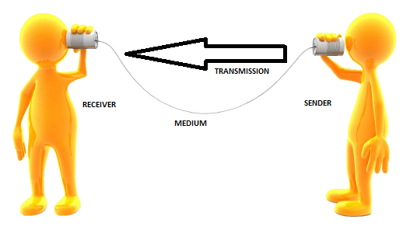
Analyzing Voice Communication
To establish voice communication following components must be needed
Sender (who sends data)
Receiver (who receives data)
Medium (through which data travels)
Information (data to be sent)
Does Communication possible with only one human (Think !!) (Sender and Receiver same with message and medium)
Something Missing !!!
Yes.. The Agreement
Agreement is boundation,
Specific Word is PROTOCOL
Protocol may define the following
What data to be send
What is the format of data
How data is to be interpreted
When data to be sent
How fast they can be sent
Thus,
Syntax,
Semantics &
Timing is defined by protocol
Does sender, receiver, medium and information is sufficient to establish communication

Slide 6
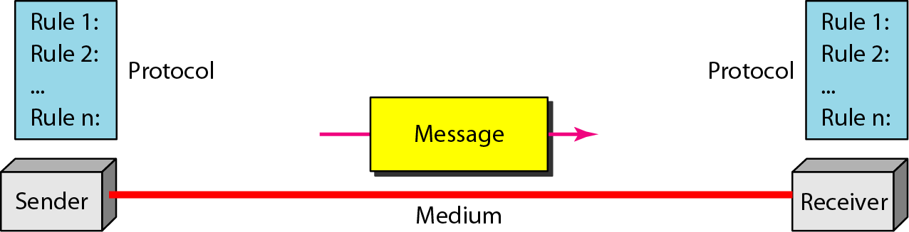
Voice Communication Vs. Data Communication
Voice Communication
Sender and Receiver (Human)
Medium (Wireless- Air)
Message (Verbal/ Non Verbal)
Protocol
Conclusion:
Minimum 2 devices required.
The devices may be geographically located anywhere.
Both devices connected with medium.
They are able to communicate hence they can exchange and share information and resources.
Resources may be file, folder, printer, disk drive or any thing that may exist on computer system.
Data Communication
Sender and Receiver (Devices)
Medium (Wired/Wireless)
Message (Data in form of bits and signals)
Protocol

Slide 7
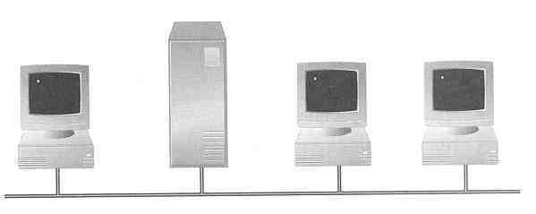

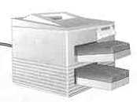
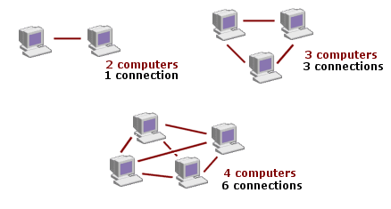
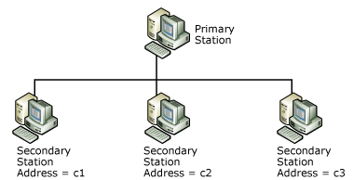
So, What is Network??
Two methods of Connecting (Based on the communication link and not devices)
Point to Point (P2P)
Multipoint
P2P: One communication link is connected by only 2 devices.
Multipoint: One communication link is connected by more than 2 devices.
How to connect ??
A network consists of 2 or more devices connected together in such a way so that they can communicate and share resources (e.g. information)
Devices???
Could be a CPU, monitor and other peripheral devices
could be a set of computers
Somewhere devices may be referred as nodes and medium as links.
WHY NETWORKING??
Thus,
A network is a set of devices (often referred to as nodes) connected by communication links.
A network as a "group of computers and associated devices that are connected by communications facilities."
A network provides two principle benefits: the ability to communicate and the ability to share.
Sharing Resources (in terms of information, hardware or software [Remember multiuser property of operating system]
Centralize administration and support [so everyone can access the same administrative or support application from their PCs]

Slide 8
So, How many Kinds of Network??
Based on Transmission Media
Based on Network Size
Based on Management Method
Based on topology (Connectivity)
Based on Data Flow Direction
Wired (UTP, Coaxial, fiber optic) or Wireless (Air, Water)
LAN, MAN and WAN
Peer to Peer and Client Server
Bus, Star, Ring, Mesh, Hybrid
Simplex, Half Duplex, Full Duplex

Slide 9
Thank You
Discussion & Doubt session will be in lecture.
Delivered By: Shabir Ali
Important terms to keep in mind
Communication
Network
Point to Point Connection
Multipoint Connection

